Slide 1
AIRCRAFT – DATABASE

Slide 2
Airline Flight information Database
FLIGHTS(no: integer, fromPlace: string, toPlace: string, distance: integer, Departs: date, arrives: date, price: real)
AIRCRAFT(aid: integer, aname: string, cruisingrange: integer)
CERTIFIED(eid: integer, aid: integer)
EMPLOYEES(eid: integer, ename: string, salary: integer)
Create tables and populate with appropriate values(Atleast 5 records in each table) for the given database

Slide 3
SCHEMA DIAGRAM
Flights
FNO
FP
TP
DISTANCE
ARRIVES
PRICE
Aircrafts
AID
ANAME
RANGE
Certified
EID
AID
Employees
EID
ENAME
SALARY

Slide 4
SCHEMA DIAGRAM
Flights
FNO
FP
TP
DISTANCE
ARRIVES
PRICE
Aircrafts
AID
ANAME
RANGE
Certified
EID
AID
Employees
EID
ENAME
SALARY

Slide 5
SCHEMA DIAGRAM
Flights
FNO
FP
TP
DISTANCE
ARRIVES
PRICE
Aircrafts
AID
ANAME
RANGE
Certified
EID
AID
Employees
EID
ENAME
SALARY

Slide 6
SCHEMA DIAGRAM
1
Flights
FNO
FP
TP
DISTANCE
ARRIVES
PRICE
Aircrafts
AID
ANAME
RANGE
2
4
Certified
EID
AID
3
Employees
EID
ENAME
SALARY

Slide 7
CREATE TABLE FLIGHTS
(no integer,
fromPlace varchar(20),
toPlace varchar(20),
distance integer,
departs date,
arrives date,
price real,
PRIMARY KEY(no));
INSERT INTO FLIGHTS VALUES(&NO,'&FROMPLACE','&TOPLACE',&DISTANCE,'&DEPARTS','&ARRIVES',&PRICE);

Slide 8
FLIGHTS
NO | FROMPLACE | TOPLACE | DISTANCE | DEPARTS | ARRIVES | PRICE
500 | BENGALURU | FRANKFURT | 2500 | 25-JUN-21 | 26-JUN-21 | 45000
501 | NAGPUR | HYDRABAD | 400 | 15-JUN-21 | 15-JUN-21 | 8000
502 | BENGALURU | FRANKFURT | 2800 | 26-JUN-21 | 27-JUN-21 | 50000
503 | BENGALURU | DELHI | 550 | 01-JUL-21 | 01-JUL-21 | 5000
504 | BENGALURU | DELHI | 600 | 01-JUL-21 | 01-JUL-21 | 6000
505 | BELAGAVI | MUMBAI | 400 | 25-JUN-21 | 25-JUN-21 | 3000

Slide 9
CREATE TABLE AIRCRAFT
(aid integer,
aname varchar(15),
cruisingrange integer,
PRIMARY KEY(aid));
INSERT INTO AIRCRAFT VALUES(&AID,'&ANAME',&CRUISINGRANGE);

Slide 10
AIRCRAFT
AID | ANAME | C_RANGE
650 | TRUEJET | 300
660 | INDIGO | 3000
670 | AIRINDIA | 2400
680 | SPICEJET | 400
690 | RELIANCE | 800
695 | TATA | 450
685 | VISTARA | 300

Slide 11
CREATE TABLE EMPLOYEES
(eid integer,
ename varchar(15),
salary integer,
PRIMARY KEY(eid));
INSERT INTO EMPLOYEES
VALUES (&EID,’&ENAME’,&SALARY);

Slide 12
EMPLOYEES
EID | ENAME | SALARY
101 | RAM | 90000
102 | ROHIT | 65000
103 | RAJ | 35000
104 | ANAND | 82000
105 | DEEPA | 92000
106 | GUNJAN | 85000

Slide 13
CREATE TABLE CERTIFIED
(eid integer,
aid integer,
PRIMARY KEY(eid, aid),
FOREIGN KEY(eid) references EMPLOYEES(eid),
FOREIGN KEY(aid) references AIRCRAFT(aid));
INSERT INTO CERTIFIED
VALUES(&EID,&AID);

Slide 14
CERTIFIED
EID | AID
101 | 650
101 | 660
101 | 670
102 | 695
103 | 670
103 | 680
104 | 695
106 | 650
106 | 660
106 | 670
106 | 680
106 | 690
103 | 685

Slide 15
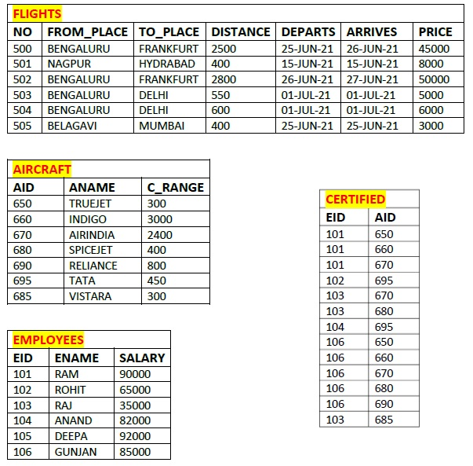

Slide 16
Write SQL queries to

Slide 17
1). Find the names of aircraft such that all pilots certified to operate them have salaries more than Rs.80,000.

Slide 18
1). Find the names of aircraft such that all pilots certified to operate them have salaries more than Rs.80,000.
SELECT DISTINCT A.aname
FROM AIRCRAFT A, CERTIFIED C, EMPLOYEES E
WHERE A.aid = C.aid AND C.eid =E.eid AND E.salary >80000;

Slide 19
2). For each pilot who is certified for more than three aircrafts,find the eid and the maximum range of the aircraft for which she or he is certified.

Slide 20
2). For each pilot who is certified for more than three aircrafts,find the eid and the maximum range of the aircraft for which she or he is certified.
SELECT C.eid, MAX(a.cruisingrange)
FROM CERTIFIED C, AIRCRAFT A
WHERE C.aid = A.aid
GROUP BY C.eid
HAVING COUNT(*) > 3;

Slide 21
3). Find the names of pilots whose salary is less than the price of the cheapest route from Bengaluru to Frankfurt.

Slide 22
3). Find the names of pilots whose salary is less than the price of the cheapest route from Bengaluru to Frankfurt.
SELECT E.ename
FROM EMPLOYEES E
WHERE E.salary < 45000;

Slide 23
3). Find the names of pilots whose salary is less than the price of the cheapest route from Bengaluru to Frankfurt.
(SELECT min(price)
FROM FLIGHTS
WHERE fromPlace = ‘BENGALURU' AND toPlace = ‘FRANKFURT');

Slide 24
3). Find the names of pilots whose salary is less than the price of the cheapest route from Bengaluru to Frankfurt.
SELECT E.ename
FROM EMPLOYEES E
WHERE E.salary < (SELECT min(price)
FROM FLIGHTS
WHERE fromPlace ='BENGALURU' AND toPlace = 'FRANKFURT');

Slide 25
4)Find the aids of all aircraft that can be used on routes from Bengaluru to New Delhi.

Slide 26
4)Find the aids of all aircraft that can be used on routes from Bengaluru to New Delhi.
SELECT A.aid
FROM AIRCRAFT A
WHERE A.cruisingrange > (SELECT max(distance)
FROM FLIGHTS
WHERE fromPlace=‘BENGALURU' AND toPlace = ‘DELHI');

Slide 27
EXTRA QUERIES

Slide 28
5). Find the names of pilots certified for some aircraft that starts with T.

Slide 29
5). Find the names of pilots certified for some Boeing aircraft.
SELECT DISTINCT E.ename
FROM AIRCRAFT A, CERTIFIED C, EMPLOYEES E
WHERE A.aid = C.aid AND C.eid = E.eid AND A.aname LIKE ‘T%';

Slide 30
6) List the employee id and name who is not certified for any aircraft.

Slide 31
6) List the employee id and name who is not certified for any aircraft.
select eid, ename
from employees
where eid in
(SELECT EID FROM EMPLOYEES
MINUS
SELECT EID FROM CERTIFIED);

